Slide 1
Deploy the portal with Azure Static Web App CLI

Slide 2
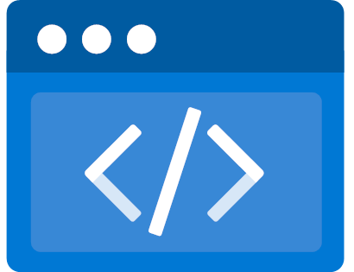
Azure Static Web Apps
Global hosting
Notes:
Azure Static Web Apps is a managed service that automatically builds and deploys full stack web apps to Azure from a code repository.
Global Hosting
Fully managed global distribution
Bring your content closer to your customers
Scale faster
Enterprise-grade edge
Enhanced security, and increased reliability without requiring configuration or coding.
Managed Azure Front Door can be used to significantly reduce latency and increase throughput
Key features
Web hosting for static content like HTML, CSS, JavaScript, and images.
Integrated API support provided by Azure Functions with the option to link an existing Azure Functions app using a standard account.
First-class GitHub and Azure DevOps integration where repository changes trigger builds and deployments.
Globally distributed static content, putting content closer to your users.
Free SSL certificates, which are automatically renewed.
Custom domains to provide branded customizations to your app.
Seamless security model with a reverse-proxy when calling APIs, which requires no CORS configuration.
Authentication provider integrations with Azure Active Directory, GitHub, and Twitter.
Customizable authorization role definition and assignments.
Back-end routing rules enabling full control over the content and routes you servGenerated staging versions powered by pull requests enabling preview versions of your site before publishing.
CLI support through the Azure CLI to create cloud resources, and via the Azure Static Web Apps CLI for local development.

Slide 3
Azure Static Web Apps
Global hosting
End-to-end development experience
Notes:
End-to-end development experience
Best-in-class end-to-end development experience
from developing and debugging to monitoring and deploying with built-in DevOps capabilities.
Tailored VS Code extension
to easily create static web apps, extend with serverless APIs, and establish a deployment workflow.
Powerful Command Line Interface (CLI)
provides a high-fidelity local replica of the cloud production environment with mocked hosting platform features for authentication, custom routing, and authorization rules to support local development.

Slide 4
Azure Static Web Apps
Global hosting
End-to-end development experience
Streamlined build and deployment
Notes:
Streamlined build and deployment
Code change driven app building and deployment
interacts directly with GitHub or Azure DevOps to monitor a branch of your choice and automatically builds and deploys apps and API to Azure.
Workflow based pre-production environment build
stage the app and enables you to perform reviews before pushing to production.
Multiple pre-production environments
can co-exist at the same time when using Azure Static Web Apps. Each time you create a pull request against the watched branch, a staged version with your changes is deployed to a distinct pre-production environment.

Slide 5

Azure Static Web Apps
Global hosting
End-to-end development experience
Streamlined build and deployment
Fully managed and cost-effective
Notes:
Fully managed and cost-effective
A serverless approach with auto scaling keep costs low by matching resources to demand. Suitable for small spiky loads to large sites with sustained traffic.
Serverless pricing model means you only pay for what you use. No need for idle capacity management and resource over-provisioning.
Automatic handling of all maintenance and updates
Always-on traffic monitoring and real-time mitigation
Built-in authentication and routing rules

Slide 6
Notes:
The portal of the Contoso Real Estate project is a simulation of a real estate agency where you can view the properties available for sale, rent, or buy. It is the main project, where it contains the home page and the components that will be used on all pages.

Slide 7

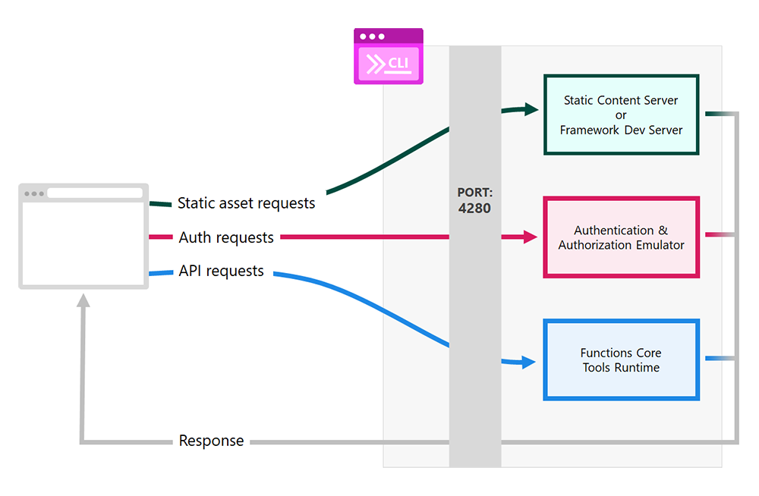
Azure Static Web Apps (SWA) CLI
Manage the e2e communication
Deploy on Azure
#
#
Notes:
The standard communication structure between frontend and backend in an Angular project is through a services.ts. In the portal project of Contoso Real Estate, the communication between frontend and backend and the deployment are managed through the Azure Static Web App CLI.
In terms of execution of the project, the SWA CLI intercepts and forwards HTTP requests to the right components based on purpose when calling APIs, which requires no CORS configuration. If you are running Contoso, you will see the portal available on the 4280 port (check the Ports tab on Codespaces) because it is the default port of the ASWA.

Slide 8
At this moment, you can run a demonstration of Contoso Real Estate on Codespace or start the workshop exercise!

